Slide 1
Zeal Education Society’s
Zeal College of Engineering and Research, PUNE - 411 041
Department of Computer Engineering
Web Technology Mini Project
(310257)

Slide 2
Web Technology Mini Project
(310257)
Third Year Computer Engineering
Name | Roll No.
Sangita Dnyanadev Mirashi | T212050
Mansi Parmar | T212064

Slide 3
NP Solutions “Innovate. Repair. Protect.”

Slide 4
Contents
Introduction
The Impact
Top Players
Problem Statement
Objectives and Goals
Existing System & Challenges
Used Technologies
Modules
Website Structure
Future Scope
Conclusion

Slide 5
Introduction – Project Overview
About NP Solutions:
Aims to bridge the gap between offline and online services for purchasing computers, requesting repairs, and booking CCTV installations.
Enhances customer satisfaction and reduces operational costs.
Purpose of This Project:
To establish a strong digital presence for NP Solutions
This project enhances customer convenience, business efficiency, and real-time engagement.
Presentation Overview:
E-commerce Impact
Problem Statement & Solution
Technologies Used
Website Structure & Flow
Business Benefits & Future Scope

Slide 6
E-Commerce Impact – Digital Market Growth
E-Commerce in Today’s Market:
Rapid Growth: Online shopping is now a trillion-dollar industry
Consumer Shift: Increased preference for convenience & accessibility
Why Businesses Need an Online Presence:
24/7 availability & wider customer reach
Enhanced brand visibility & credibility
Automated processes for efficiency & growth
Industry Insights:
E-commerce sales are expected to grow 10-15% annually
Businesses without a digital presence risk losing market share

Slide 7
Top Players – Leading E-Commerce
Top Global E-Commerce Platforms:
Amazon, Alibaba, eBay, Shopify – Dominating worldwide markets
Top Indian E-Commerce Platforms:
Flipkart, Meesho, Myntra, Nykaa – Driving digital shopping in India
Key Success Factors:
User-friendly experience – Easy navigation & seamless transactions
Secure payments & logistics – Faster delivery & multiple payment options
Strong digital marketing – SEO, ads & customer engagement

Slide 8
Problem Statement
Develop an online platform for purchasing computers, requesting repairs, and booking CCTV installation, bridging offline and online operations for better customer experience and efficiency.

Slide 9
Objectives and Goals
Establish an online marketplace for computers & laptops.
Enable seamless booking for repair services.
Provide hassle-free CCTV installation bookings.
Automate order tracking and service requests.
Enhance customer engagement through real-time support.

Slide 10
Existing System & Challenges
Electronics shop operates entirely offline.
Customers must visit the store for inquiries.
Manual order tracking leads to inefficiencies.
Lack of automated service requests and product availability checks.

Slide 11
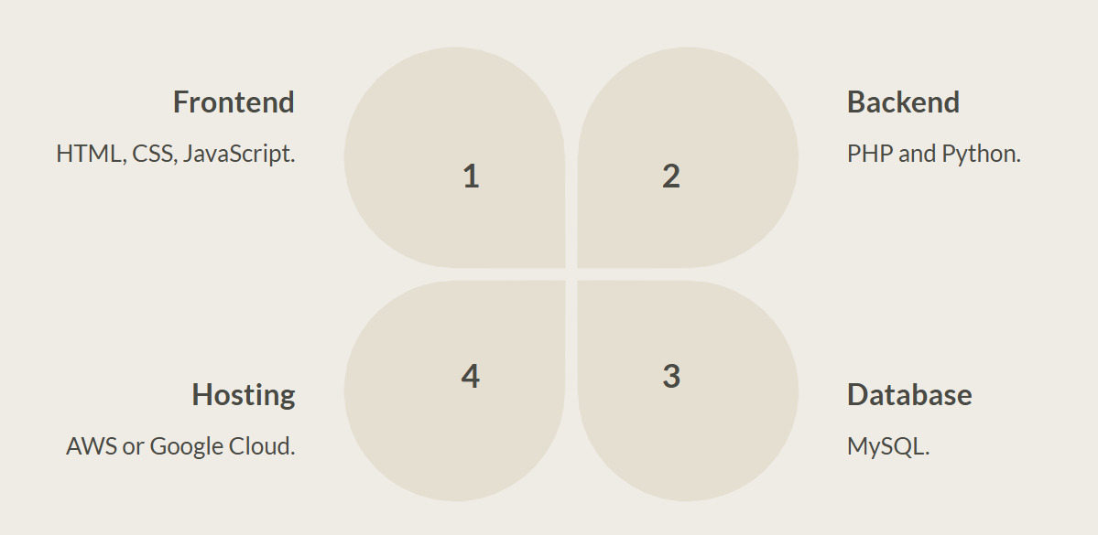
Used Technologies – Our Tech Stack

Slide 12
Modules
User Module: Registration, Login, Profile Management
Product Catalog: Computer & Laptop Listings
Repair Services: Request Repair Services
CCTV Services: Booking & Service Status
Admin Panel: Inventory & Order Tracking

Slide 13
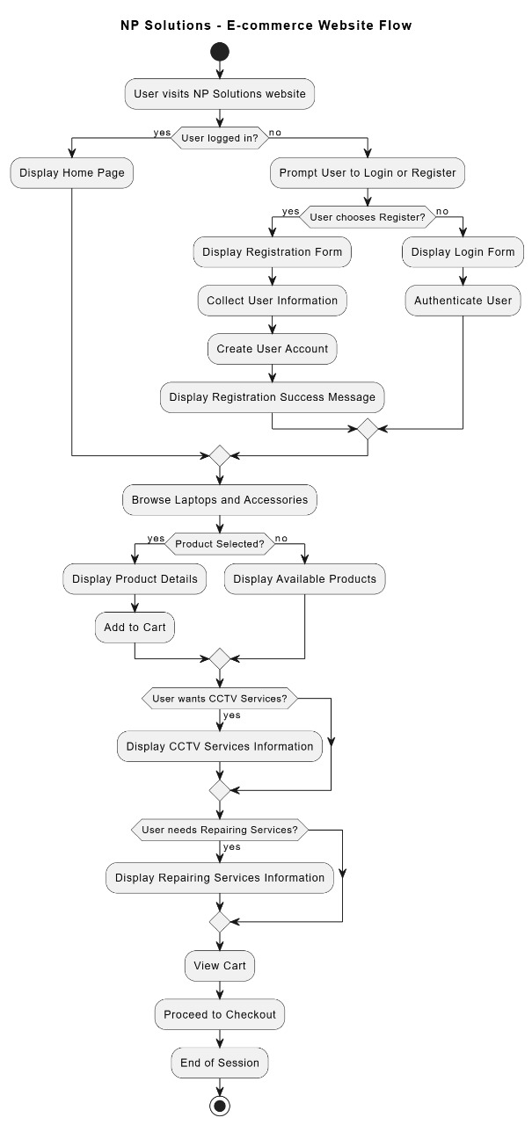
Website Structure – Site Map

Slide 14
Future Scope
🚀 Artificial Intelligence (AI) Smart chatbots & automation
📱 Progressive Web Apps (PWA) Faster mobile experiences
🔗 Blockchain Payments Secure & transparent transactions
☁️ Cloud Scalability Handling growing business needs
📊 Advanced Analytics Tracking visitor insights & behavior

Slide 15
Conclusion
NP Solutions bridges the offline-online gap with a unified platform for computer sales, repairs, and CCTV installations. By leveraging cloud computing, AI automation, and secure payments, it enhances customer experience, boosts efficiency, and scales business operations. This solution improves satisfaction, speeds up service, and cuts costs, positioning NP Solutions as a competitive industry player. Future advancements like AI-driven support and predictive maintenance will further strengthen its capabilities.

Slide 16


